Slide 1

Team Nautilus
The Shipwreck Protocol

Slide 2
The Shipwreck Protocol
All
Team Lead 1 - Kenny - Boss Fights
Team Lead 2 - Sam - Level Design
Team Lead 3 - Davin - UI + Menus
Team Lead 4 - Shawn - Items + Audio
Team Lead 5 - Alice - Enemies + Art
Team Lead 6 - Ben - Controls/Main character movement

Slide 3
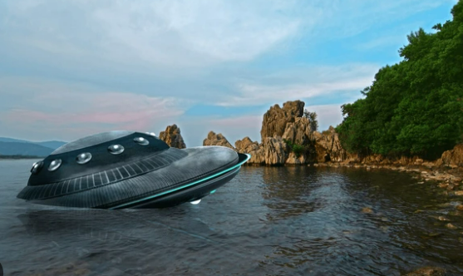
The Shipwreck Protocol
Shawn Young
Genre
2D Platformer
Metroidvania
Theme
Spaceship Underwater
Goal
Escape!

Slide 4
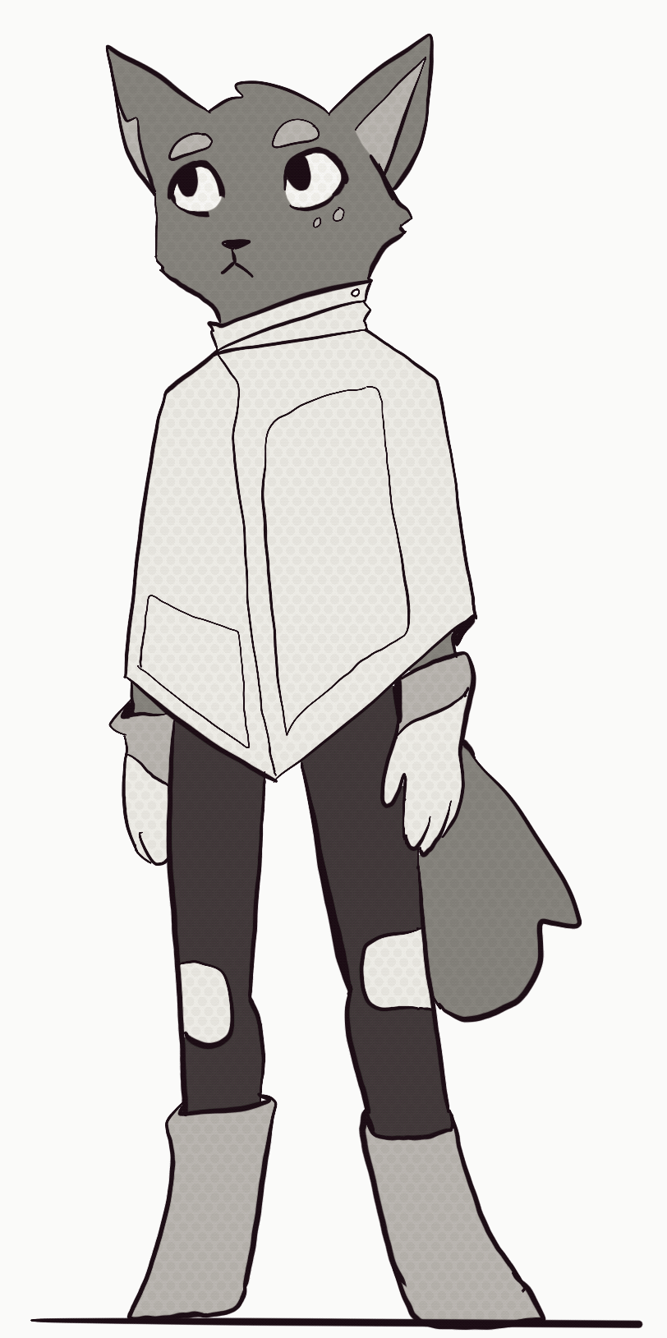
Storyboard - Alice
You are Miko, an employee aboard a small cargo ship. You’re transporting goods back to your headquarters when something goes wrong with your ship. Although you attempt to stop the crash into a nearby planet, it’s too late. You are knocked to the ground and pass out as the ship slams into unknown waters. Minutes later, you awaken; but time is running out. You need to get to the escape pod and get out as quickly as possible, before the water-or things in the water- terminate your existence.

Slide 5
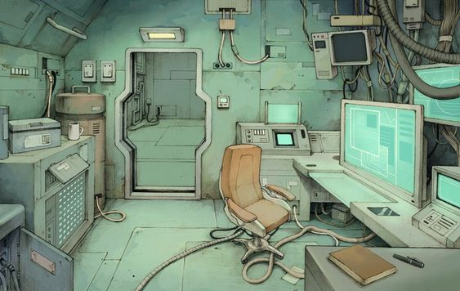
Storyboard - Ben
Game begins with a black screen, and white text describing what’s happening to the player(ship is crashing). Player then receives first objective: initiate The Shipwreck Protocol by typing in a code to open the escape pod room.

Slide 6
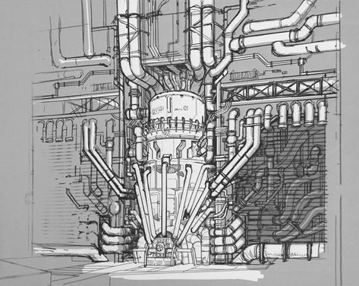
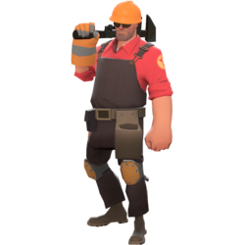
Storyboard - Kenny
Player then enters the room containing
the escape pod, until they realize the
pod is broken. Their next objective is
to get the repair kit to repair the pod.
This will be the main objective for
the rest of the game. To unlock the
next room, they need to first collect an
Item from the controls room and open
the other door to the med bay)

Slide 7
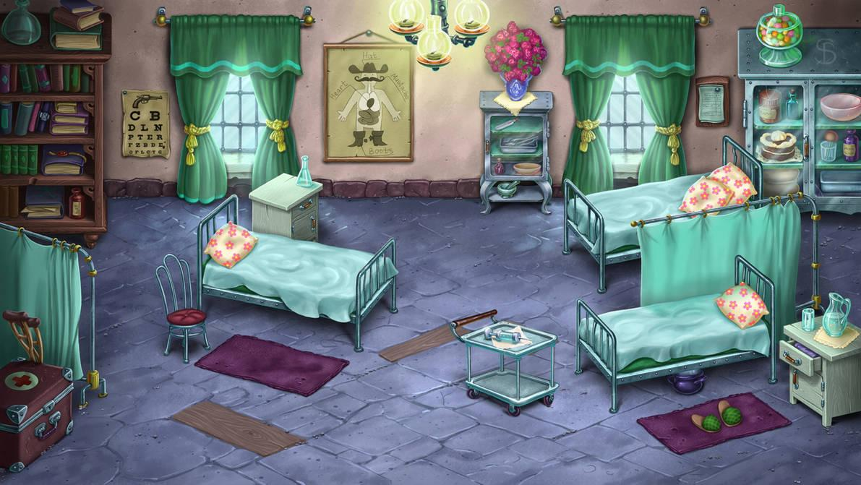

Storyboard - Alice
When the player reaches the medicine bay, they meet their first enemies, but also medicine packs which they can use to gain back lost health. Once they’ve killed the enemies, they are able to access the next room- the armory, where the player can upgrade their fighting abilities

Slide 8
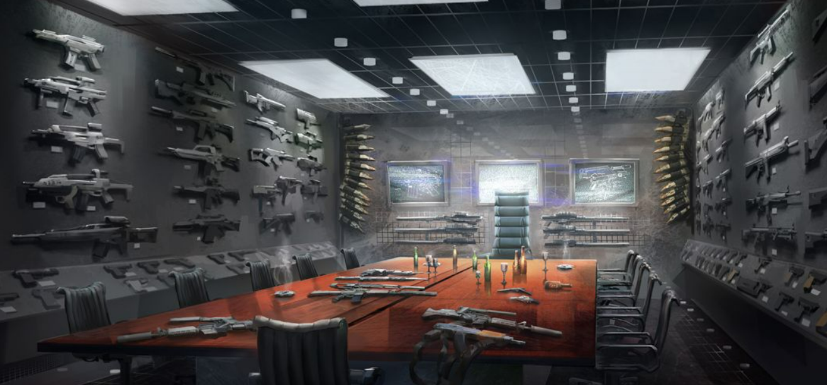
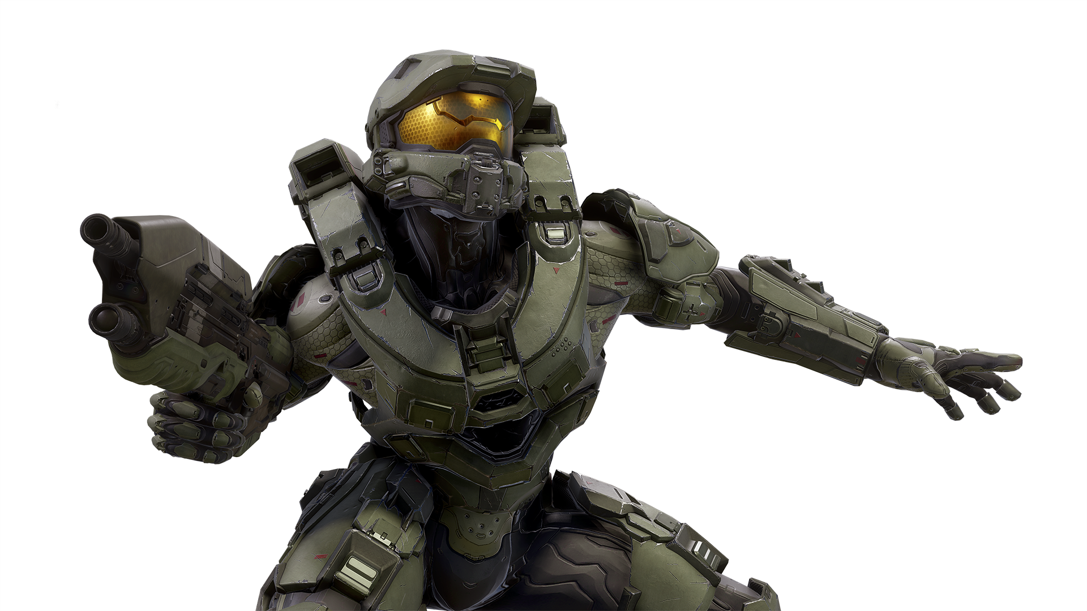
Storyboard - Shawn
Upon reaching the Armory, the player can upgrade their weapon. The player can also access the ship’s digital alert log, where they read that there is a breach in the cargo bay and lower rooms! Watch out, water and life forms are coming in!

Slide 9
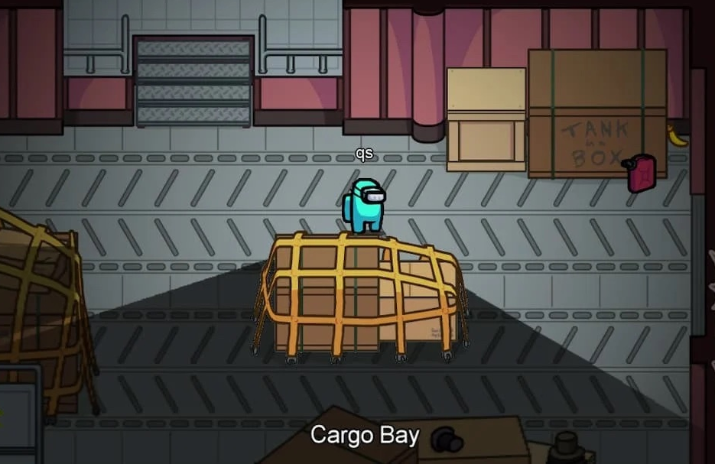
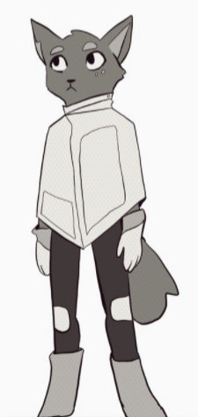

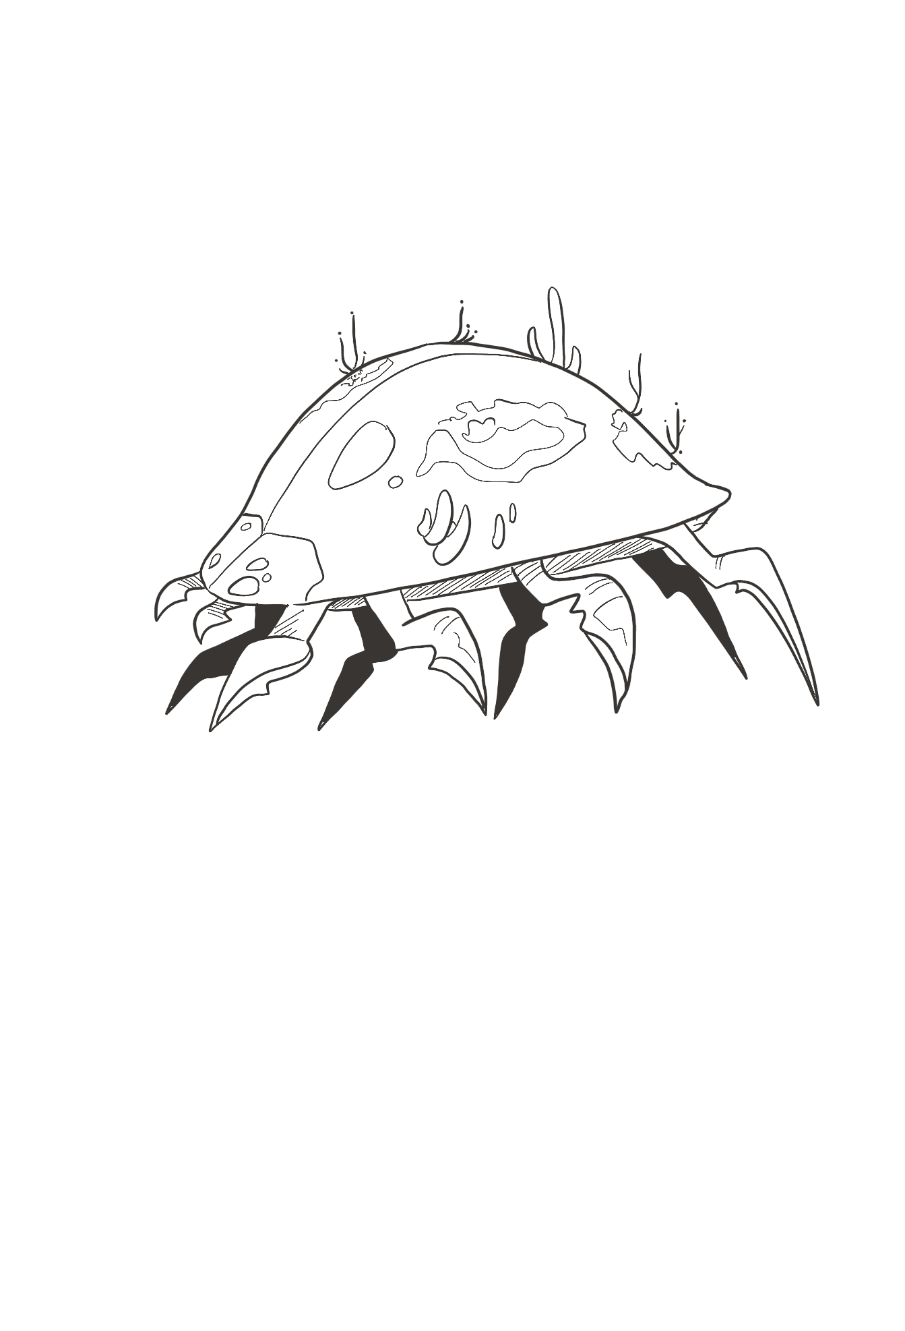
Storyboard - Kenny
In the cargo bay, the player must jump from box to box as water is flooding in. They also have to fight off alien crab creatures that are swimming in through holes in the ship..

Slide 10



Storyboard - Davin
Submerged Section
Part of the ship is submerged
underwater after the
shipwreck. Here, the player
will encounter new enemies
and the final boss fight, after which they
can retrieve the repair kit and
return to the escape pod to finish
the game.

Slide 11

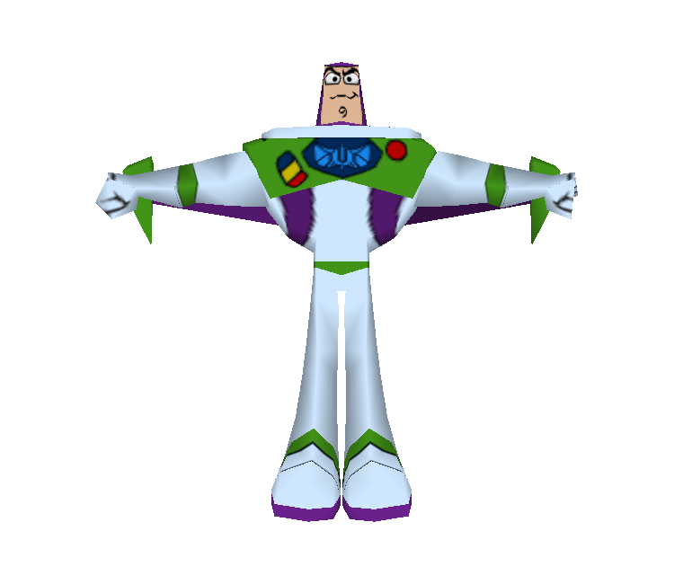

Storyboard - Sam
Once you have recovered the repair kit Miko can make their way to back to the Escape Pod! Watch out! It may be a bit more dangerous on the return trip. Escape!

Slide 12
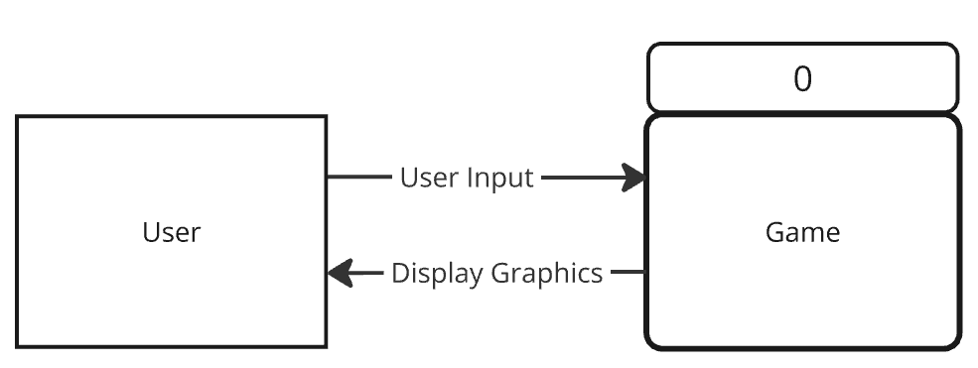
Context Diagram - Alice

Slide 13
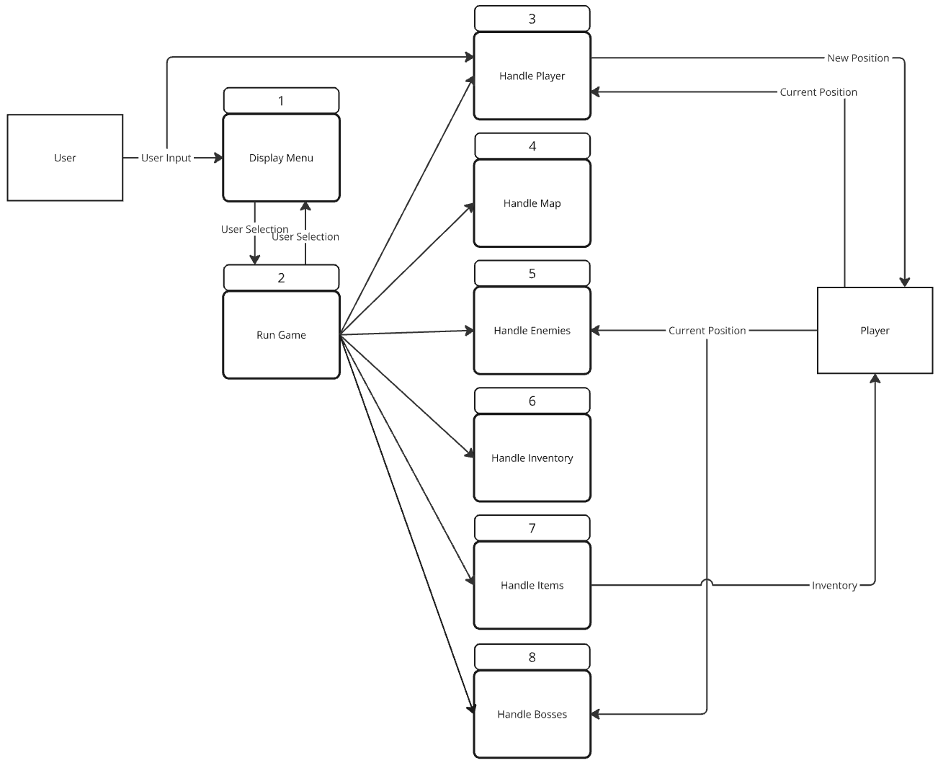
Diagram 0
Notes:
UI action tells game to open the level
Level adds the player
Player picks up item (weapon)
Item removes itself from the map
Player uses weapon to attack an enemy
Player gets close enough to a boss
Boss attacks player
Player takes damage

Slide 14
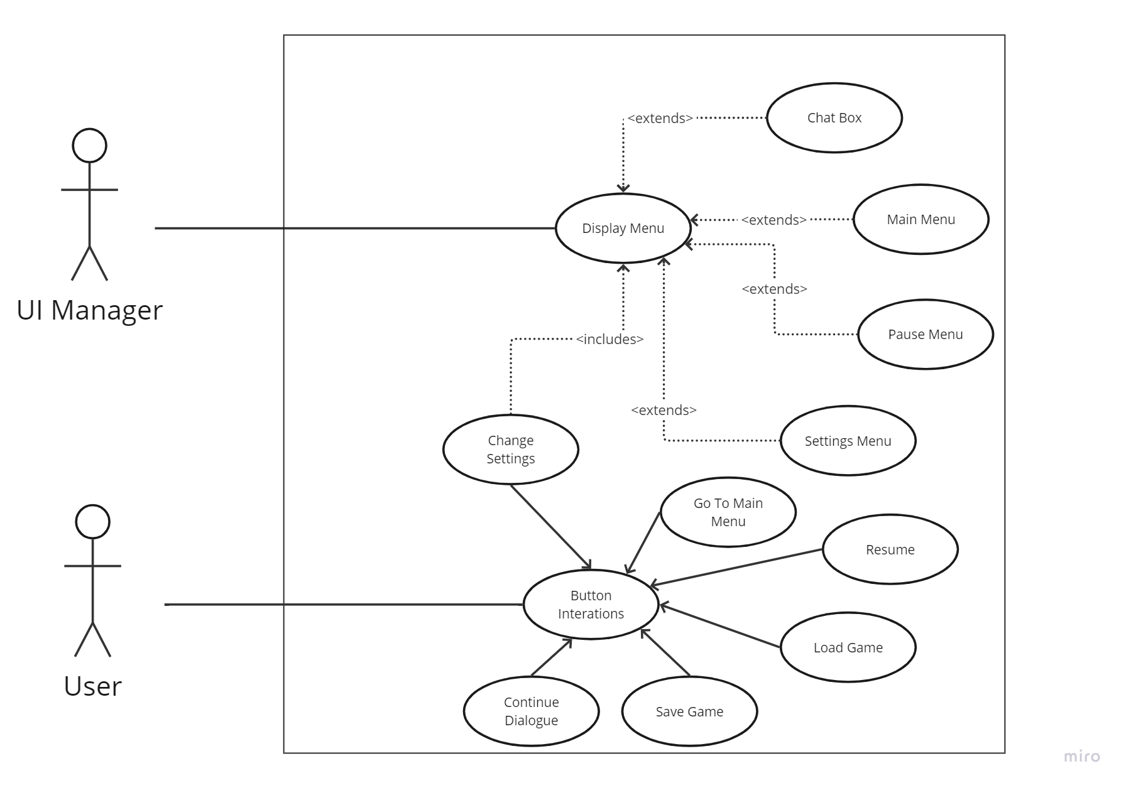
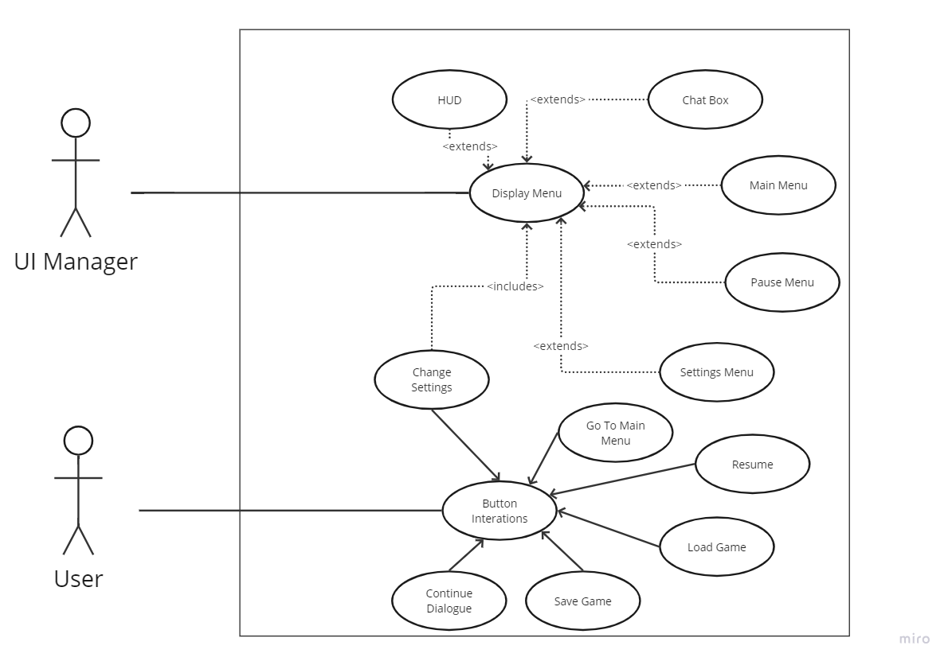

UI/ Menus priority 2-essential
Use Case
Davin Lewis

Slide 15
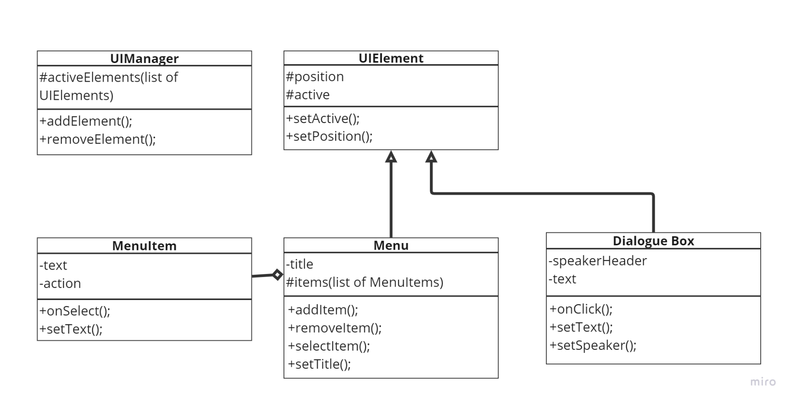
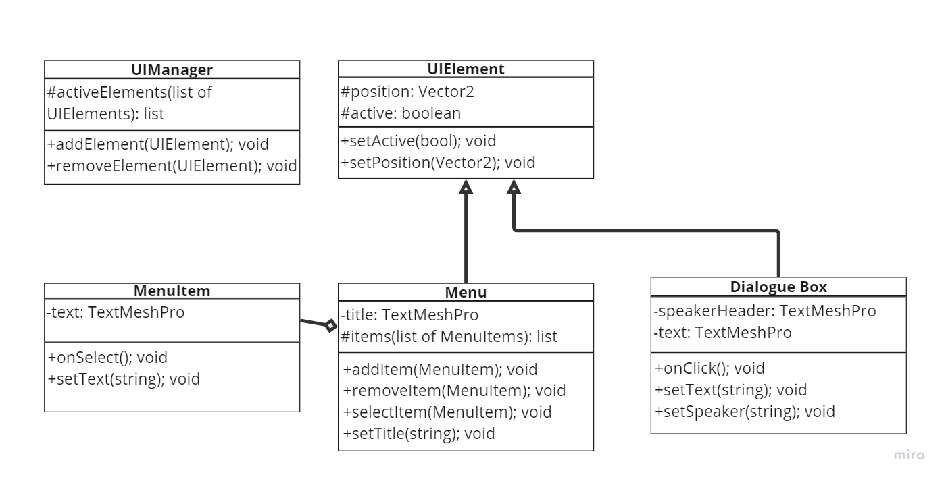
UI/ Menus complexity-low
Class Diagram
Davin Lewis

Slide 16
Level Design
Sam Robinson
Handling the environment, objects, and entities.
Priority: 1 - Must have
Complexity: Light/Medium

Slide 17
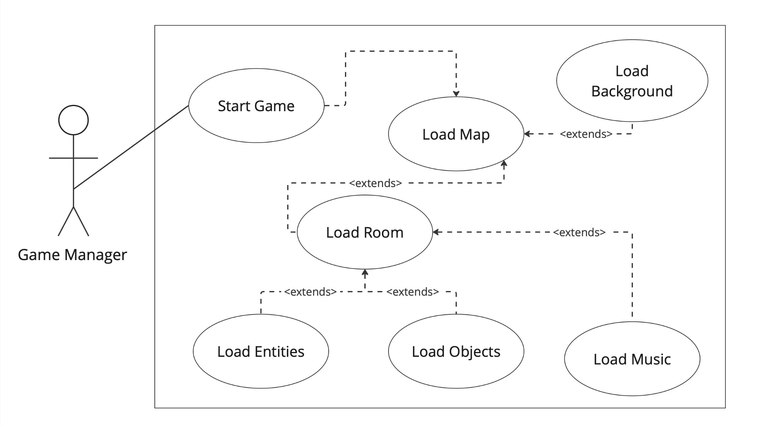
Level Design Use Case
Sam Robinson

Slide 18
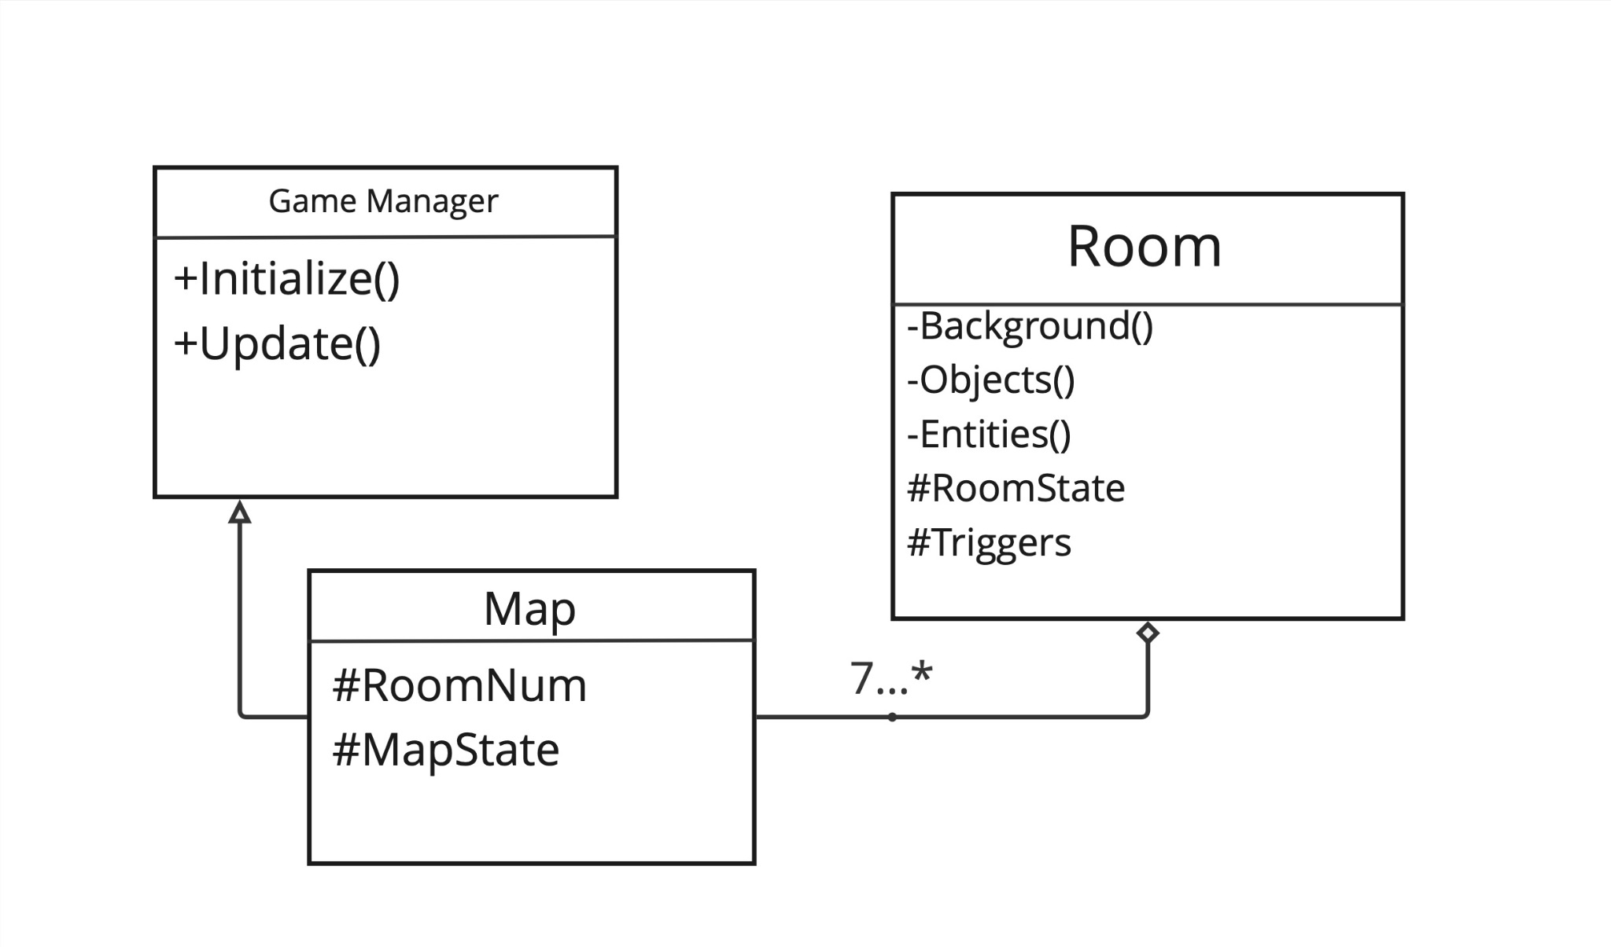
Level Design Class Diagram
Sam Robinson

Slide 19
User Input & Player Movement
Ben Bonus
Handles the input from the User and uses it to give the player movement.
Priority: 1 - Must have
Complexity: Average

Slide 20
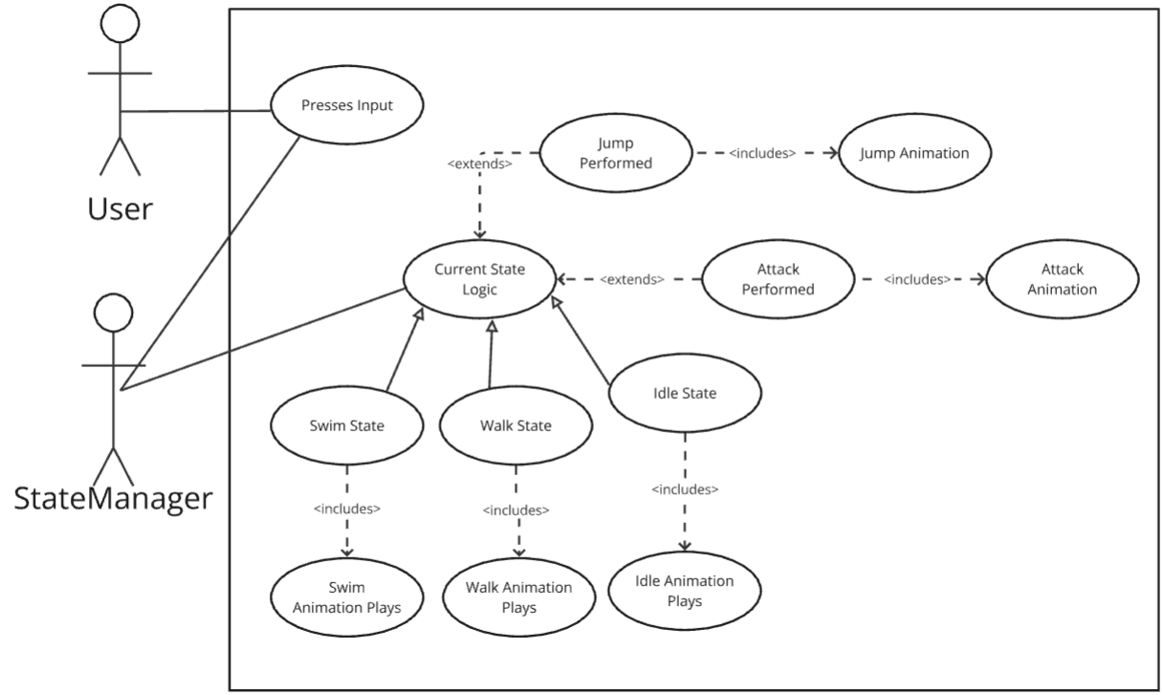
User Input & Player Movement
Use Case
Ben Bonus

Slide 21
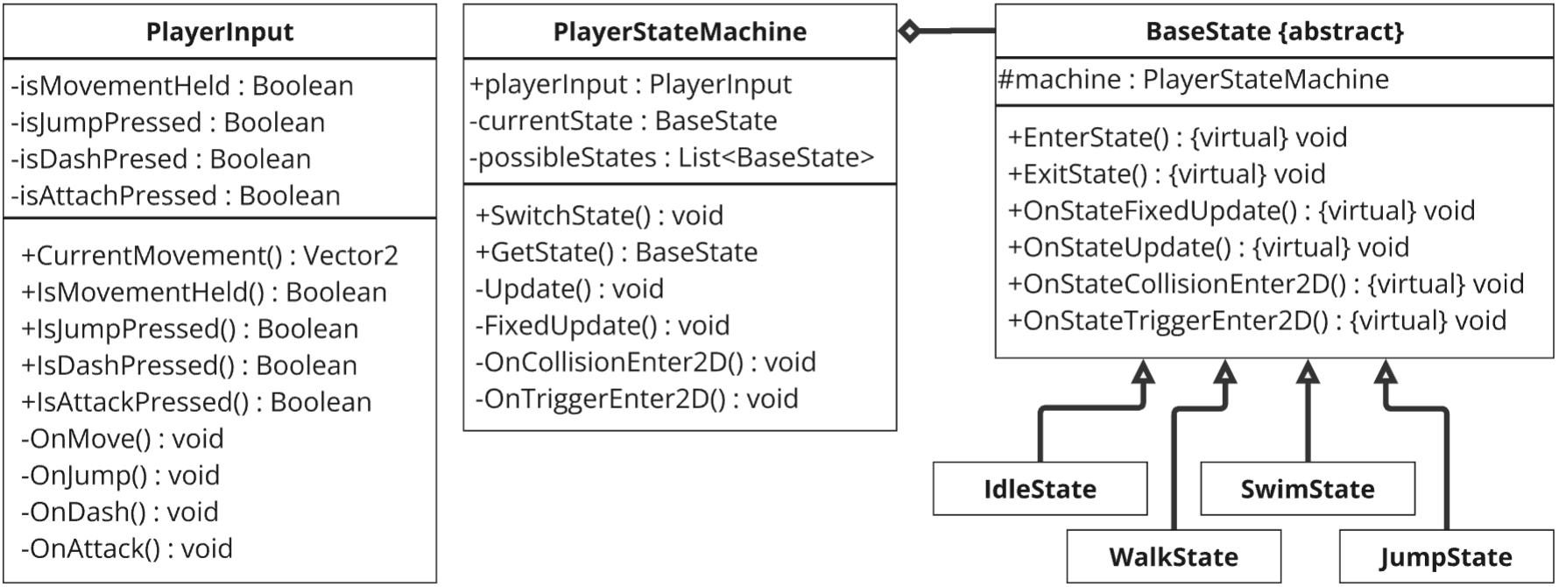
User Input & Player Movement
Class Diagram
Ben Bonus

Slide 22
Enemies -complexity: intermediate
Alice Miller
-different types of small enemies that spawn the player can avoid or interact with
-some stationary, some moving/patrolling, different types of attacks
-intermediate complexity
-priority: essential but not must-have
Notes:
introduce name and feature, list complexity level,

Slide 23
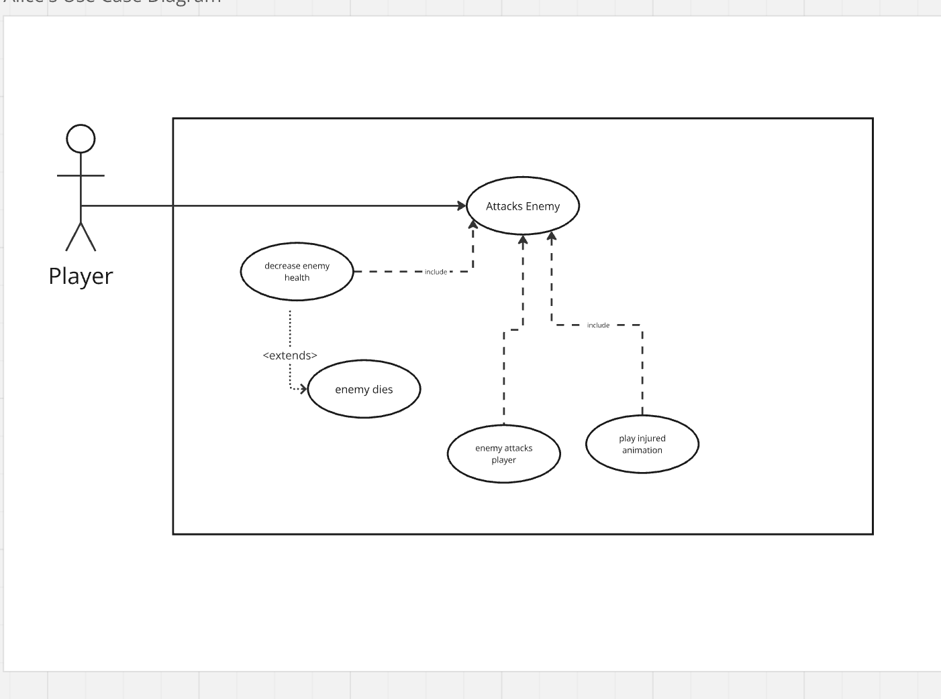
Enemies Use Case-complexity: intermediate
Alice Miller
Notes:
introduce name and feature, list complexity level,

Slide 24
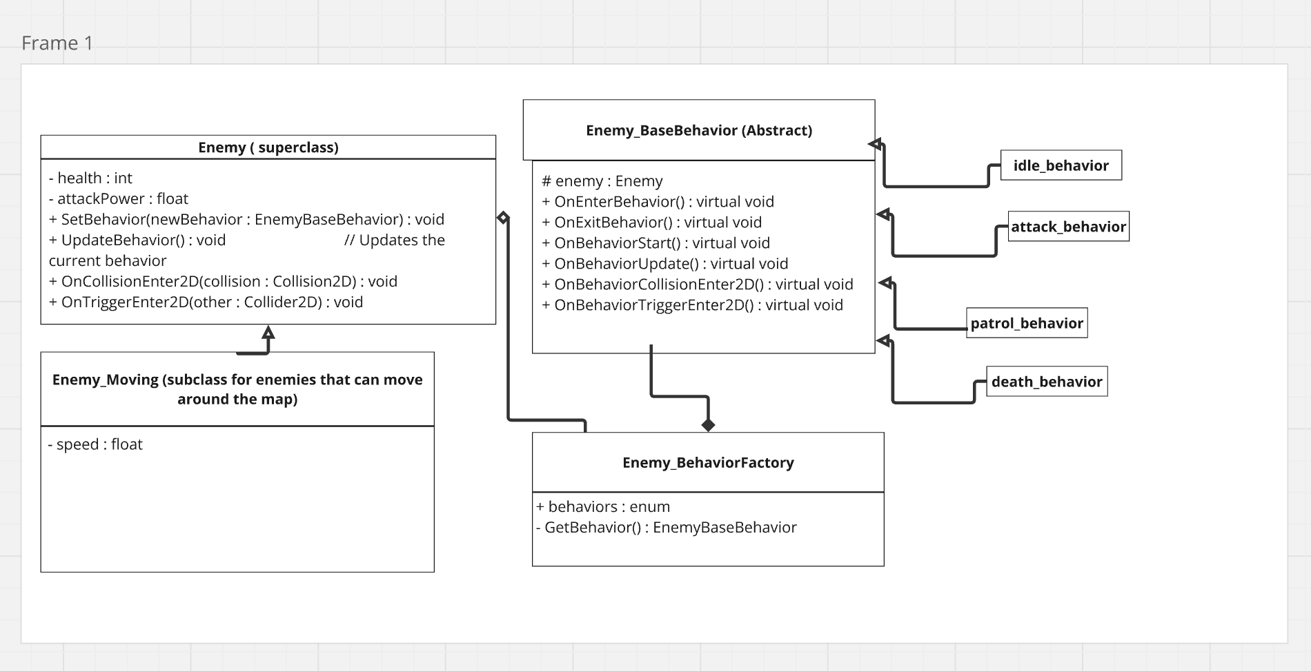
Enemies Class Diagram -priority: essential
Alice Miller
Notes:
introduce name and feature, list complexity level,

Slide 25
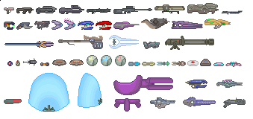

Items/Collectables
Shawn Young
Feature: Collectables include different consumables, items and weapons.
Priority: Essential (2)/Nice to have (3)
Complexity: Medium/Low

Slide 26
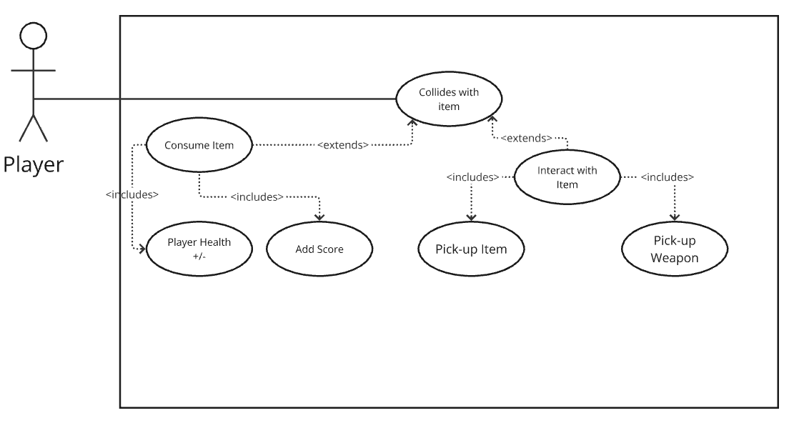
Items/Collectables Use Case
Shawn Young

Slide 27
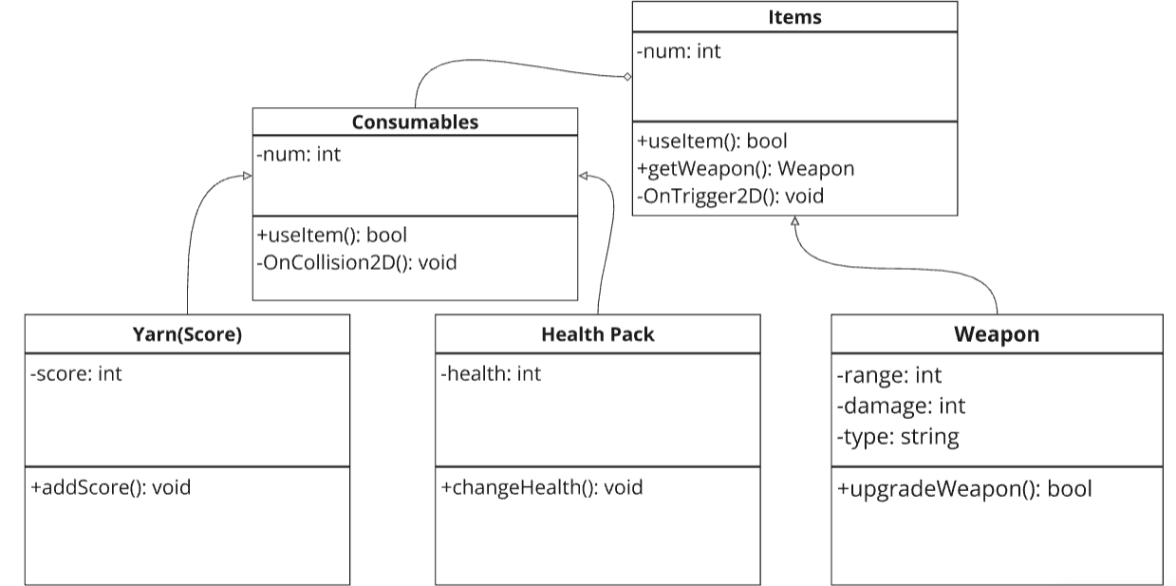
Items/Collectables Class Diagram
Shawn Young

Slide 28
Boss Fights
Kenny Kline
One main boss at the end of the game, others scattered throughout the map
Priority - 2
Complexity - Intermediate (Similar to other features)
Notes:
Re-introduce
Tell how high of a priority your feature is: Essential (game would still function without boss fights, it just wouldn’t be fun)
Estimate the complexity of the work relative to the other features (about the same)

Slide 29
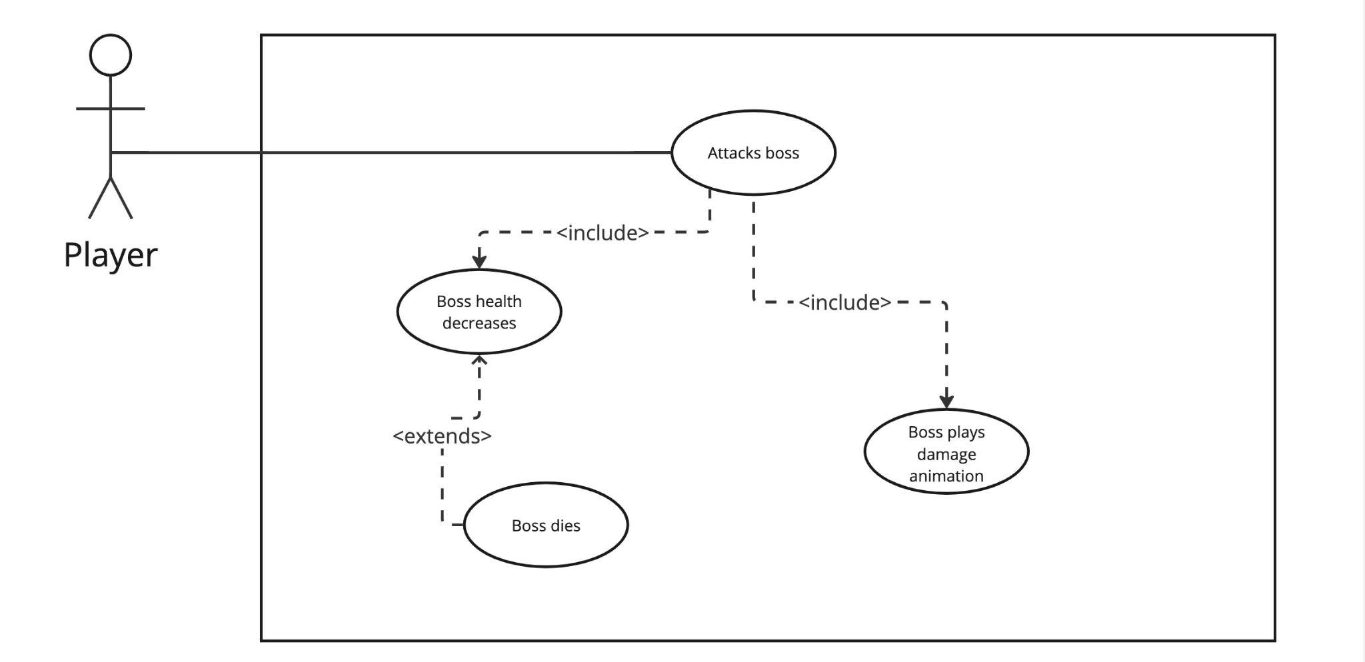
Boss Fights Use Case Diagram
Kenny Kline
Notes:
Re-introduce
Tell how high of a priority your feature is: Essential (game would still function without boss fights, it just wouldn’t be fun)
Estimate the complexity of the work relative to the other features (about the same)

Slide 30
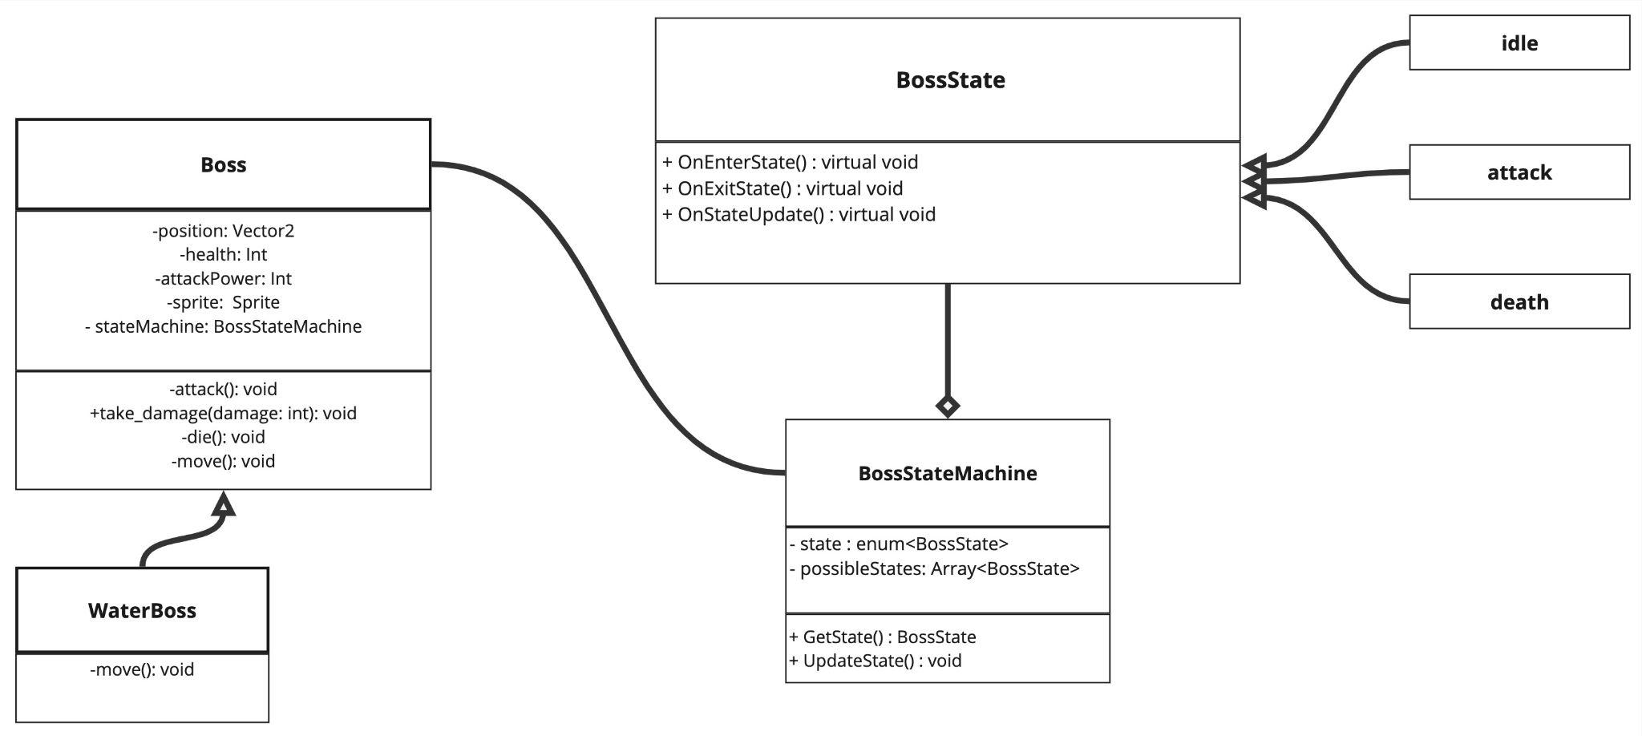
Boss Fights Class Diagram
Kenny Kline

Slide 31
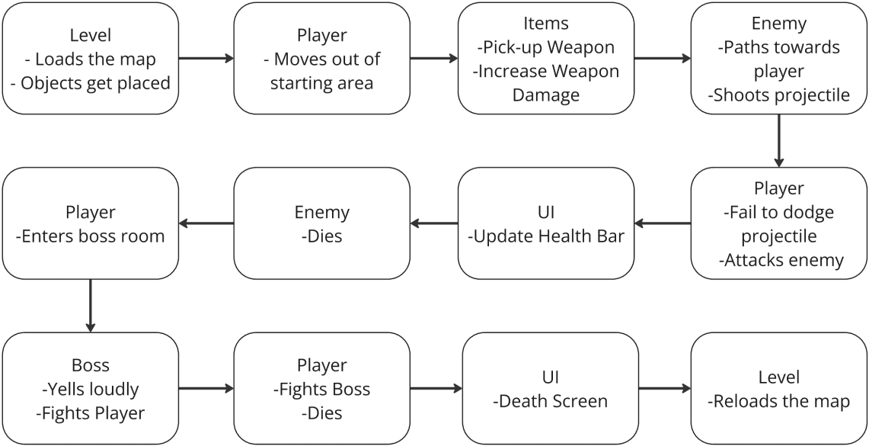
Global Use Case

Slide 32
Team Nautilus
Questions?

